Slide 1

Unit-1 Introduction to Cloud Computing
Introduction to Advanced Technologies (IAT)
DU #2104CS521
Prof. Umesh H Thoriya
Computer Science & Engineering
umesh.thoriya@darshan.ac.in
9714233355

Slide 2

Looping
Outline
What is Cloud Computing?
Advantages & Disadvantages
Origin of Cloud
Cloud Computing Architecture
Cloud Computing Technologies
Cloud Computing Vs Grid Computing
How Cloud Works?
Application and Security Risk
Types of Cloud
Cloud Service Model
Cloud Service Providers
Feature of Cloud Computing
Cloud Computing Job – Career

Slide 3
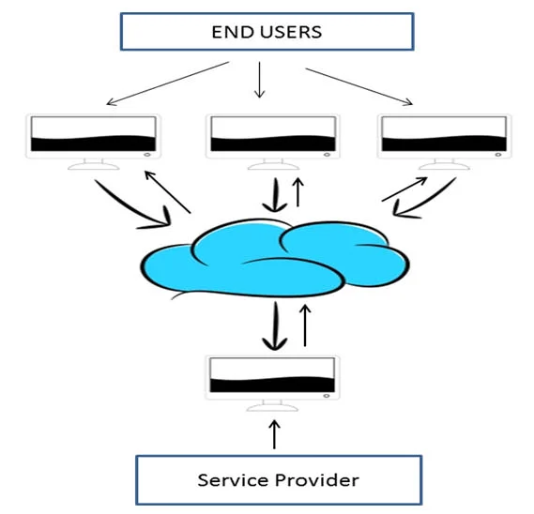
What is Cloud Computing?
Cloud Computing is defined as storing and accessing of data and computing services over the internet.
It doesn’t store any data on your personal computer.
It is the on-demand availability of computer services like servers, data storage, networking, databases, etc.
The term cloud refers to a network or the internet.
It is a technology that uses remote servers on the internet to store, manage, and access data online rather than local drives.
The data can be anything such as files, images, documents, audio, video, and more.

Slide 4

What is Cloud Computing?

Slide 5
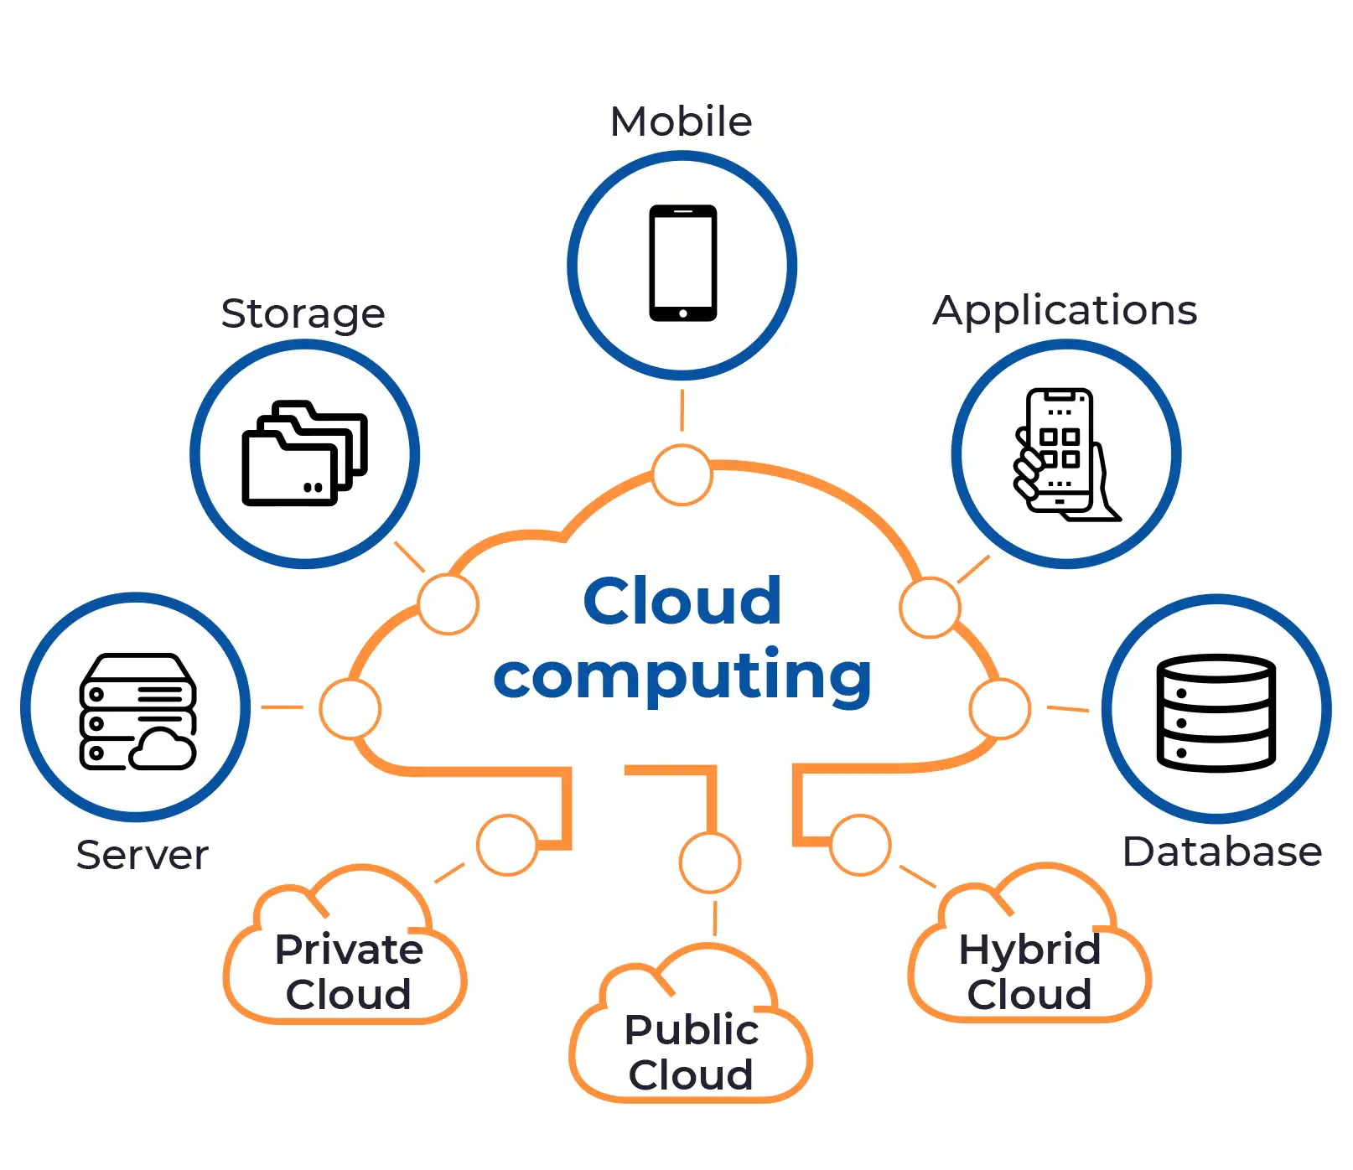
Operation of Cloud Computing
Developing new applications and services
Storage, back up, and recovery of data
Hosting blogs and websites
Delivery of software on demand
Analysis of data
Streaming videos and audios

Slide 6
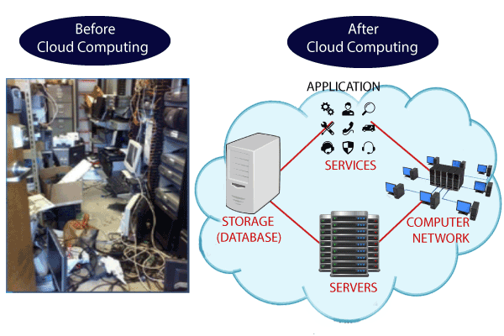
Why Cloud Computing?
Small as well as large IT companies, follow the traditional methods to provide the IT infrastructure.
For any IT company, we need a Server Room that is the basic need of IT companies.
There should be a database server, mail server, networking, firewalls, routers, modem, switches, Query Per Second means how much queries or load will be handled by the server, configurable system, high net speed, and the maintenance engineers.
To establish such IT infrastructure, we need to spend lots of money.
To overcome all these problems and to reduce the IT infrastructure cost, Cloud Computing comes into existence.

Slide 7
Characteristics of Cloud Computing
Agility
The cloud works in a distributed computing environment. It shares resources among users and works very fast.
High availability and reliability
The availability of servers is high and more reliable because the chances of infrastructure failure are minimum.
High Scalability
Cloud offers "on-demand" provisioning of resources on a large scale, without having engineers for peak loads.
Multi-Sharing
Multiple users and applications can work more efficiently with cost reductions by sharing common infrastructure.
Device and Location Independence
It enables the users to access systems using a web browser regardless of their location or what device they use e.g. PC, mobile phone, etc.
As infrastructure is off-site and accessed via the Internet, users can connect from anywhere.

Slide 8
Characteristics of Cloud Computing – Cont.
Maintenance
Maintenance of cloud computing applications is easier, since they do not need to be installed on each user's computer and can be accessed from different places.
Low Cost
The cost will be reduced because to take the services of cloud computing, IT company need not to set its own infrastructure and pay-as-per usage of resources.
Services in the pay-per-use mode
Application Programming Interfaces (APIs) are provided to the users so that they can access services on the cloud by using these APIs and pay the charges as per the usage of services.

Slide 9
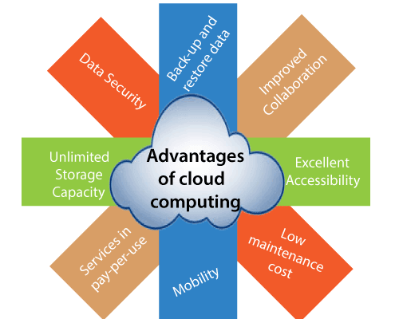
Advantages of Cloud Computing
Back-up and Restore data
Improved Collaboration
Excellent Accessibility – Anytime - Anywhere
Low Maintenance Cost
Mobility
Services in the pay-per-use Model
Unlimited Storage Capacity
Data security

Slide 10
Disadvantages of Cloud Computing
Internet Connectivity
Vendor Lock-in
Limited Control
Security

Slide 11
Origin of Cloud
Client/Server computing which is basically a centralized storage in which all the software applications, all the data and all the controls are resided on the server side.
Distributed computing came into picture, where all the computers are networked together and share their resources when needed.
Distributed computing has certain limitations. So in order to remove limitations faced in distributed system, cloud computing was emerged.
In 1999, Salesforce.com
In 2002, Amazon started Amazon Web Services.
In 2009, Google started GCP.
In 2009, Microsoft launched Windows Azure.
Client/Server Computing
Distributed Computing
Cloud Computing

Slide 12
Cloud Computing Architecture

Slide 13
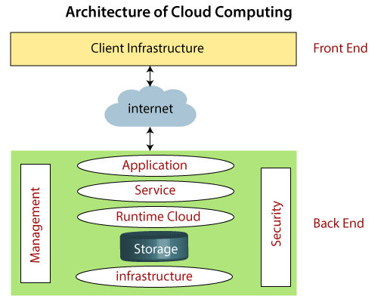
Cloud Computing Architecture
Cloud computing technology is used by both small and large organizations to store the information in cloud and access it from anywhere at anytime using the internet connection.
Cloud computing architecture is a combination of service-oriented architecture and event-driven architecture.
It is divided into the following two parts:
Front End
Back End

Slide 14
Cloud Computing Architecture – Cont.
Front End:
The front end is used by the client.
It contains client-side interfaces and applications that are required to access the cloud computing platforms.
The front end includes web servers (including Chrome, Firefox, internet explorer, etc.), tablets, and mobile devices.
Back End:
The back end is used by the service provider.
It manages all the resources that are required to provide cloud computing services.
It includes a huge amount of data storage, security mechanism, virtual machines, deploying models, servers, traffic control mechanisms, etc.

Slide 15
Components of Cloud Computing Architecture
Client Infrastructure
Client Infrastructure is a Front end component. It provides GUI (Graphical User Interface) to interact with the cloud.
Application
The application may be any software or platform that a client wants to access.
Service
A Cloud Services manages that which type of service you access according to the client’s requirement.
Software as a Service (SaaS)
Example: Google Apps, Salesforce Dropbox, Slack, Hubspot, Cisco WebEx.
Platform as a Service (PaaS)
Example: Windows Azure, Force.com, Magento Commerce Cloud, OpenShift.
Infrastructure as a Service (IaaS)
Example: Amazon Web Services (AWS) EC2, Google Compute Engine (GCE), Cisco Metapod.

Slide 16
Components of Cloud Computing Architecture – Cont.
Runtime Cloud
Runtime Cloud provides the execution and runtime environment to the virtual machines.
Storage
Storage is one of the most important components of cloud computing. It provides a huge amount of storage capacity in the cloud to store and manage data.
Infrastructure
It provides services on the host level, application level, and network level.
Cloud infrastructure includes hardware and software components such as servers, storage, network devices, virtualization software, and other storage resources that are needed to support the cloud computing model.
Management
It is used to manage components such as application, service, runtime cloud, storage, infrastructure, and other security issues in the backend and establish coordination between them.
Security
Security is an in-built back end component of cloud computing. It implements a security mechanism in the back end.
Internet
The Internet is medium through which front end and back end can interact and communicate with each other.

Slide 17
Cloud Computing Technology
Virtualization
Service-Oriented Architecture (SOA)
Grid Computing
Utility Computing

Slide 18
Virtualization
Virtualization is the process of creating a virtual environment to run multiple applications and operating systems on the same server.
The virtual environment can be anything like single instance or a combination of many operating systems, storage devices, network application servers, and other environments.
The concept of Virtualization in cloud computing increases the use of virtual machines.
A virtual machine is a software computer or software program that not only works as a physical computer.
It can function as a physical machine and perform tasks such as running applications or programs as per the user's demand.

Slide 19
Types of Virtualization
Hardware virtualization
Server virtualization
Storage virtualization
Operating system virtualization
Data Virtualization

Slide 20
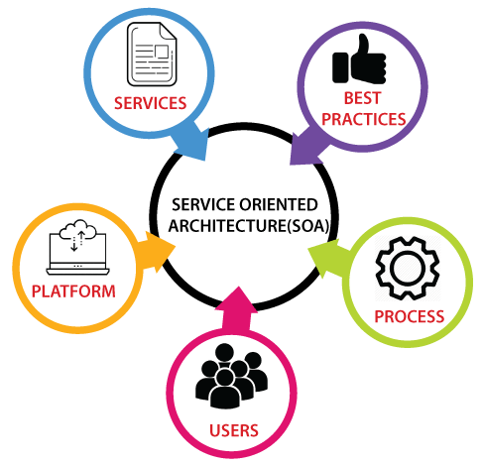
Service-Oriented Architecture (SOA)
It allows organizations to access on-demand cloud-based computing solutions according to the change of business needs.
It can work without or with cloud computing.
The advantages of using SOA is that it is easy to maintain, platform independent, and highly scalable.
Service Provider and Service consumer are the two major roles within SOA.
Application:
Healthcare Industry
To create many mobile applications and games
In the air force, SOA infrastructure is used to deploy situational awareness systems.

Slide 21
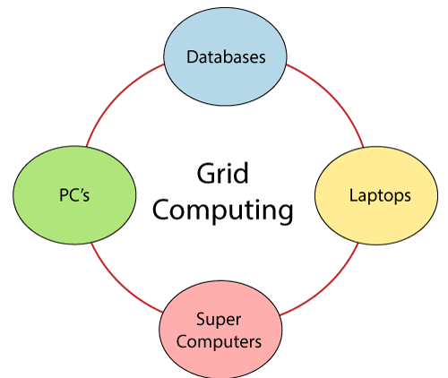
Grid Computing
Grid computing is also known as distributed computing.
It is a processor architecture that combines various different computing resources from multiple locations to achieve a common goal.
The grid is connected by parallel nodes to form a computer cluster.
These computer clusters are in different sizes and can run on any operating system.

Slide 22
Grid Computing – Cont.
Grid computing contains the following three types of machines:
Control Node:
It is a group of server which administrates the whole network.
Provider:
It is a computer which contributes its resources in the network resource pool.
User:
It is a computer which uses the resources on the network.
Application:
ATMs
Back-end infrastructures and marketing research.

Slide 23
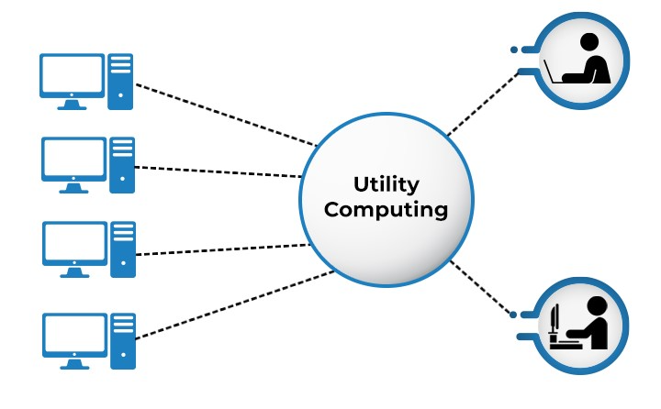
Utility Computing
It is the most trending IT service model.
It provides on-demand computing resources like computation, storage, and programming services via API and infrastructure based on the pay per use method.
It minimizes the associated costs and maximizes the efficient use of resources.
The advantage is that it reduced the IT cost, provides greater flexibility, and easier to manage.
Large organizations such as Google and Amazon established their own utility services for computing storage and application.

Slide 24
Cloud Computing Vs Grid Computing
Cloud Computing | Grid Computing
It follows client-server computing architecture. | It follows a distributed computing architecture.
Scalability is high. | Scalability is normal.
It is more flexible than grid computing. | It is less flexible than cloud computing.
Cloud operates as a centralized management system. | Grid operates as a decentralized management system.
Cloud servers are owned by infrastructure providers. | grids are owned and managed by the organization.
It uses services like Iaas, PaaS, and SaaS. | It uses systems like distributed computing, distributed information, and distributed pervasive.
It is Service-oriented. | It is Application-oriented.
It is accessible through standard web protocols. | It is accessible through grid middleware.

Slide 25
Application & Security Risk
Application:
Entertainment
Business
Education
Social Media Application
Art Application
Data Storage Application
Security Risk
Data Loss
Hacked Interfaces and Insecure APIs
Data Breach
Vendor Lock-in
Complexity - Skill IT staff
Cyber attack

Slide 26
Types of Cloud

Slide 27
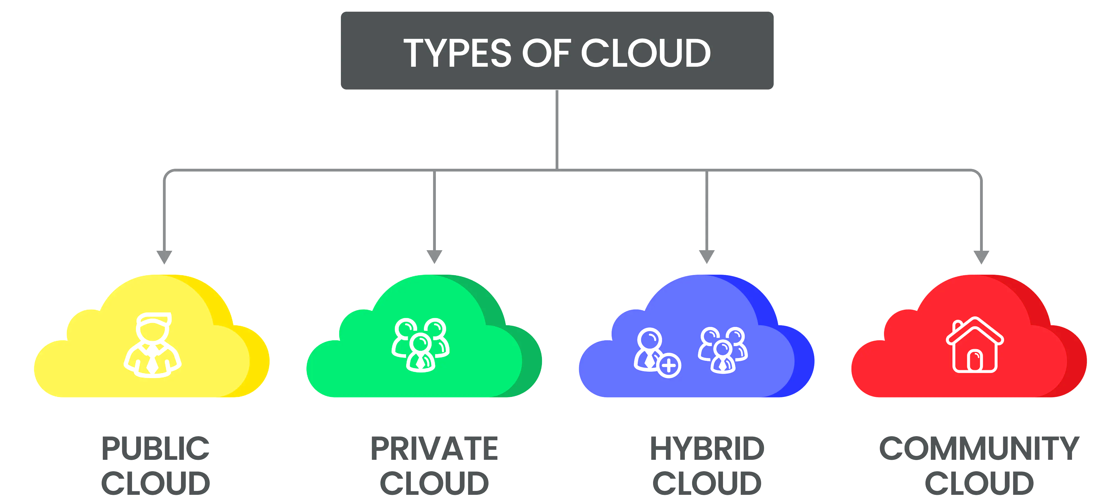
Types of Cloud
Public cloud is a type of computing where resources are offered by a third-party provider via the internet and shared by organizations and individuals who want to use or purchase them.

Slide 28
Types of Cloud
Private cloud is defined as computing services offered either over the Internet or a private internal network and only to select users instead of the general public.

Slide 29
Types of Cloud
Hybrid cloud is a mixed computing environment where applications are run using a combination of computing, storage, and services in different environments - public clouds and private clouds, including on-premises data centers.

Slide 30
Types of Cloud
Community cloud computing refers to a shared cloud computing service environment that is targeted to a limited set of organizations or employees (such as banks or heads of trading firms).

Slide 31
Public Cloud

Slide 32
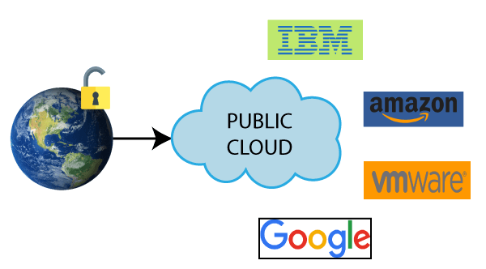
Public Cloud
Public cloud is open to all to store and access information via the Internet using the pay-per-usage method.
Computing resources are managed and operated by the Cloud Service Provider (CSP).
Example: Amazon elastic compute cloud (EC2), IBM SmartCloud Enterprise, Microsoft, Google App Engine, Windows Azure Services Platform.

Slide 33
Public Cloud – Cont.
Advantages of Public Cloud
It is owned at a lower cost than the private and hybrid cloud.
It is maintained by the cloud service provider, so do not need to worry about the maintenance.
It is easier to integrate. Hence it offers a better flexibility approach to consumers.
It is location independent because its services are delivered through the internet.
It is highly scalable as per the requirement of computing resources.
It is accessible by the general public, so there is no limit to the number of users.
Disadvantages of Public Cloud
It is less secure because resources are shared publicly.
Performance depends upon the high-speed internet network link to the cloud provider.
The Client has no control of data.

Slide 34
Private Cloud

Slide 35
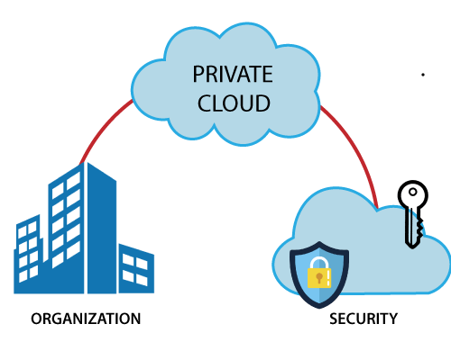
Private Cloud
Private cloud is also known as an internal cloud or corporate cloud.
It is used by organizations to build and manage their own data centers internally or by the third party.
It can be deployed using Opensource tools such as Openstack and Eucalyptus.
Based on the location and management, National Institute of Standards and Technology (NIST) divide private cloud into the following two parts:
On-premise private cloud
Outsourced private cloud

Slide 36
Private Cloud – Cont.
Advantages of Private Cloud
It provides a high level of security and privacy to the users.
It offers better performance with improved speed and space capacity.
It allows the IT team to quickly allocate and deliver on-demand IT resources.
The organization has full control over the cloud because it is managed by the organization itself. So, there is no need for the organization to depends on anybody.
It is suitable for organizations that require a separate cloud for their personal use and data security is the first priority.
Disadvantages of Private Cloud
Skilled people are required to manage and operate cloud services.
It is accessible within the organization, so the area of operations is limited.

Slide 37
Hybrid Cloud

Slide 38
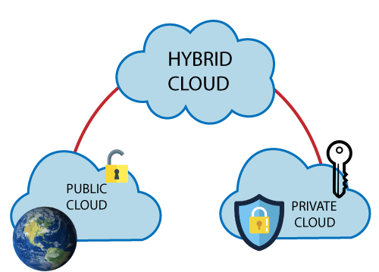
Hybrid Cloud
Hybrid Cloud is a combination of the public cloud and the private cloud.
Hybrid Cloud = Public Cloud + Private Cloud
It is partially secure because the services which are running on the public cloud can be accessed by anyone.
While the services which are running on a private cloud can be accessed only by the organization's users.
Example: Google Application Suite (Gmail, Google Apps, and Google Drive), Office 365 (MS Office on the Web and One Drive), Amazon Web Services.

Slide 39
Hybrid Cloud – Cont.
Advantages of Hybrid Cloud
It is suitable for organizations that require more security than the public cloud.
It helps you to deliver new products and services more quickly.
It provides an excellent way to reduce the risk.
It offers flexible resources because of the public cloud and secure resources because of the private cloud.
Disadvantages of Hybrid Cloud
Security feature is not as good as the private cloud.
Managing a hybrid cloud is complex because it is difficult to manage more than one type of deployment model.
The reliability of the services depends on cloud service providers.

Slide 40
Community Cloud

Slide 41
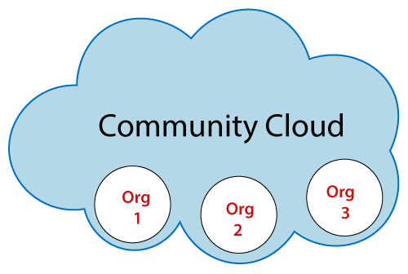
Community Cloud
Community cloud allows systems and services to be accessible by a group of several organizations.
To share the information between the organization and a specific community.
It is owned, managed, and operated by one or more organizations in the community, a third party, or a combination of them.
Example: Health Care community cloud

Slide 42
Community Cloud – Cont.
Advantages of Community Cloud
It is cost-effective because the whole cloud is being shared by several organizations or communities.
It is suitable for organizations that want to have a collaborative cloud with more security features than the public cloud.
It provides better security than the public cloud.
It provides collaborative and distributive environment.
It allows us to share cloud resources, infrastructure, and other capabilities among various organizations.
Disadvantages of Community Cloud
It is not a good choice for every organization.
Security features are not as good as the private cloud.
It is not suitable if there is no collaboration.
The fixed amount of data storage and bandwidth is shared among all community members.

Slide 43
Public Cloud Vs. Private Cloud Vs. Hybrid Cloud Vs. Community Cloud
Parameter | Public Cloud | Private Cloud | Hybrid Cloud | Community Cloud
Host | Service provider | Enterprise (Third party) | Enterprise (Third party) | Community (Third party)
Users | General public | Selected users | Selected users | Community members
Access | Internet | Internet, VPN | Internet, VPN | Internet, VPN
Owner | Service provider | Enterprise | Enterprise | Community

Slide 44
Cloud Service Models
IaaS, PaaS, SaaS

Slide 45
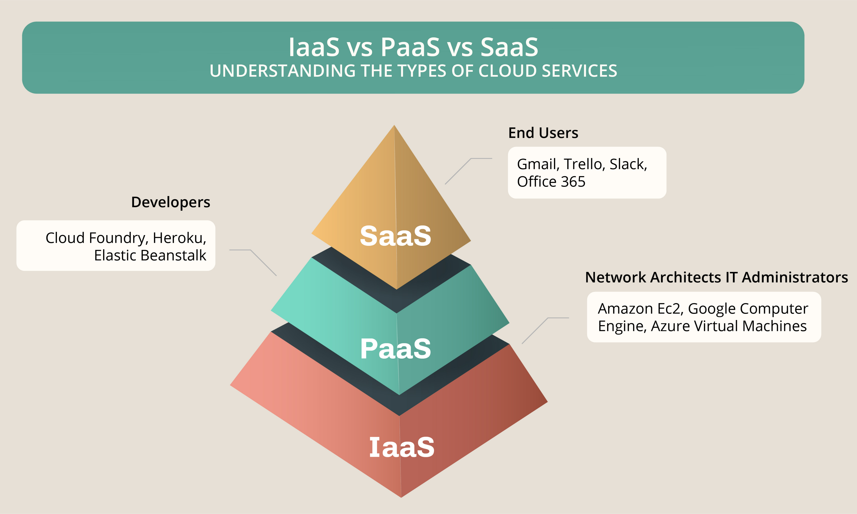
Cloud Service Models
There are the following three types of cloud service models:
Infrastructure as a Service (IaaS)
Platform as a Service (PaaS)
Software as a Service (SaaS)

Slide 46
Infrastructure as a Service (IaaS)
IaaS is also known as Hardware as a Service (HaaS).
It is a computing infrastructure managed over the internet.
The main advantage of using IaaS is that it helps users to avoid the cost and complexity of purchasing and managing the physical servers.
Characteristics of IaaS:
Resources are available as a service
Services are highly scalable
Dynamic and flexible
GUI and API-based access
Automated administrative tasks
Example: DigitalOcean, Linode, Amazon Web Services (AWS), Microsoft Azure, Google Compute Engine (GCE), Rackspace, and Cisco Metacloud.

Slide 47
Platform as a Service (PaaS)
PaaS cloud computing platform is created for the programmer to develop, test, run, and manage the applications.
Characteristics of PaaS:
Accessible to various users via the same development application.
Integrates with web services and databases.
Builds on virtualization technology, so resources can easily be scaled up or down as per the organization's need.
Support multiple languages and frameworks.
Provides an ability to "Auto-scale".
Example: AWS Elastic Beanstalk, Windows Azure, Heroku, Force.com, Google App Engine, Apache Stratos, Magento Commerce Cloud, and OpenShift.

Slide 48
Software as a Service (SaaS)
SaaS is also known as "on-demand software".
It is a software in which the applications are hosted by a cloud service provider.
Users can access these applications with the help of internet connection and web browser.
Characteristics of SaaS:
Managed from a central location
Hosted on a remote server
Accessible over the internet
Users are not responsible for hardware and software updates. Updates are applied automatically.
The services are purchased on the pay-as-per-use basis
Example: BigCommerce, Google Apps, Salesforce, Dropbox, ZenDesk, Cisco WebEx, ZenDesk, Slack, and GoToMeeting.

Slide 49
IaaS Vs. PaaS Vs. SaaS
IaaS | PaaS | SaaS
It provides a virtual data center to store information and create platforms for app development, testing, and deployment. | It provides virtual platforms and tools to create, test, and deploy apps. | It provides web software and apps to complete business tasks.
It provides access to resources such as virtual machines, virtual storage, etc. | It provides runtime environments and deployment tools for applications. | It provides software as a service to the end-users.
It is used by network architects. | It is used by developers. | It is used by end users.
IaaS provides only Infrastructure. | PaaS provides Infrastructure + Platform. | SaaS provides Infrastructure + Platform + Software.

Slide 50
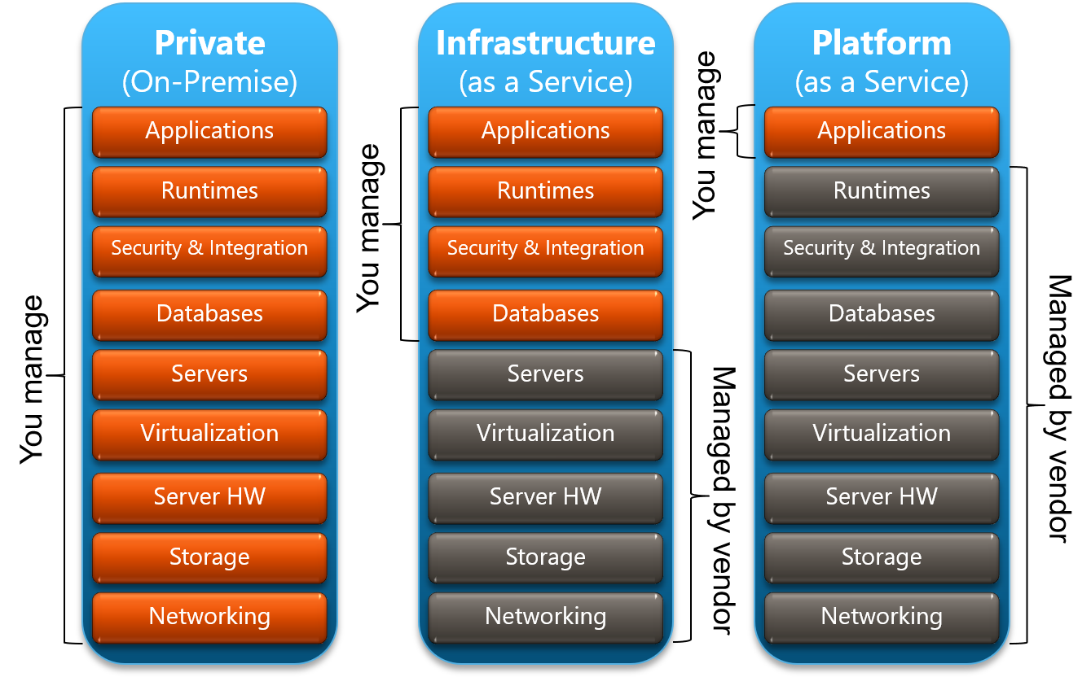

Slide 51
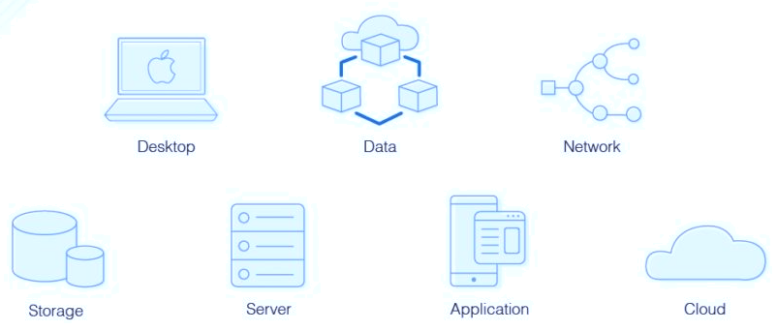
Virtualization in Cloud Computing
Virtualization is the "creation of a virtual (rather than actual) version of something, such as a server, a desktop, a storage device, an operating system or network resources".
Virtualization is a technique, which allows to share a single physical instance of a resource or an application among multiple customers and organizations.

Slide 52
Virtualization in Cloud Computing – Cont.
What is the concept behind the Virtualization?
Creation of a virtual machine over existing operating system and hardware is known as Hardware Virtualization.
A Virtual machine provides an environment that is logically separated from the underlying hardware.
The machine on which the virtual machine is going to create is known as Host Machine and that virtual machine is referred as a Guest Machine.
Types of Virtualization:
Hardware Virtualization
Operating system Virtualization
Server Virtualization
Storage Virtualization

Slide 53
Hardware Virtualization
The virtual machine software or virtual machine manager (VMM) is directly installed on the hardware system is known as hardware virtualization.
The main job of hypervisor is to control and monitoring the processor, memory and other hardware resources.
After virtualization of hardware system we can install different operating system on it and run different applications on those OS.
Usage:
Hardware virtualization is mainly done for the server platforms, because controlling virtual machines is much easier than controlling a physical server.

Slide 54
Operating System Virtualization
The virtual machine software or virtual machine manager (VMM) is installed on the Host operating system instead of directly on the hardware system is known as operating system virtualization.
Usage:
Operating System Virtualization is mainly used for testing the applications on different platforms of OS.

Slide 55
Server Virtualization
The virtual machine software or virtual machine manager (VMM) is directly installed on the Server system is known as server virtualization.
Usage:
Server virtualization is done because a single physical server can be divided into multiple servers on the demand basis and for balancing the load.

Slide 56
Storage Virtualization
Storage virtualization is the process of grouping the physical storage from multiple network storage devices so that it looks like a single storage device.
Storage virtualization is also implemented by using software applications.
Usage:
Storage virtualization is mainly done for back-up and recovery purposes.

Slide 57
Cloud Service Provider

Slide 58
Cloud Service Provider
Amazon Web Services (AWS)
Microsoft Azure
Google Cloud Platform
IBM Cloud Services
VMware Cloud
Oracle Cloud
Red Hat
Digital Ocean
Rackspace
Alibaba Cloud

Slide 59
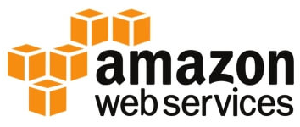
Amazon Web Services (AWS)
AWS (Amazon Web Services) is a secure cloud service platform provided by Amazon.
It offers various services such as database storage, computing power, content delivery, Relational Database, Simple Email, Simple Queue, and other functionality to increase the organization's growth.
Features of AWS:
AWS is scalable because it has an ability to scale the computing resources up or down according to the organization's demand.
AWS is cost-effective as it works on a pay-as-you-go pricing model.
It provides various flexible storage options.
It offers various security services such as infrastructure security, data encryption, monitoring & logging, identity & access control, penetration testing, and DDoS attacks.
It can efficiently manage and secure Windows workloads.

Slide 60
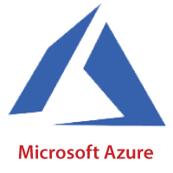
Microsoft Azure
Microsoft Azure is also known as Windows Azure.
It supports various operating systems, databases, programming languages, frameworks that allow IT professionals to easily build, deploy, and manage applications through a worldwide network.
It also allows users to create different groups for related utilities.
Features of Microsoft Azure:
Microsoft Azure provides scalable, flexible, and cost-effective.
It allows developers to quickly manage applications and websites.
It managed each resource individually.
Its IaaS infrastructure allows us to launch a general-purpose virtual machine in different platforms such as Windows and Linux.
It offers a Content Delivery System (CDS) for delivering the Images, videos, audios, and applications.

Slide 61
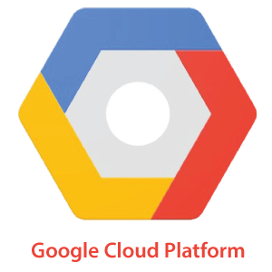
Google Cloud Platform
Google cloud platform is a product of Google.
It consists of a set of physical devices, such as computers, hard disk drives, and virtual machines.
It also helps organizations to simplify the migration process.
Features of Google Cloud
Google cloud includes various big data services such as Google BigQuery, Google CloudDataproc, Google CloudDatalab, and Google Cloud Pub/Sub.
It provides various services related to networking, including Google Virtual Private Cloud (VPC), Content Delivery Network, Google Cloud Load Balancing, Google Cloud Interconnect, and Google Cloud DNS.
It offers various scalable and high-performance
GCP provides various serverless services such as Messaging, Data Warehouse, Database, Compute, Storage, Data Processing, and Machine learning (ML)
It provides a free cloud shell environment with Boost Mode.

Slide 62
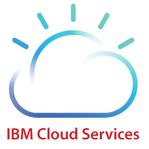
IBM Cloud
IBM Cloud is an open-source, faster, and more reliable platform.
It is built with a suite of advanced data and AI tools.
It offers various services such as Infrastructure as a service, Software as a service, and platform as a service.
You can access its services like compute power, cloud data & Analytics, cloud use cases, and storage networking using internet connection.
Feature of IBM Cloud:
IBM cloud improves operational efficiency.
Its speed and agility improve the customer's satisfaction.
It offers Infrastructure as a Service (IaaS), Platform as a Service (PaaS), as well as Software as a Service (SaaS)
It offers various cloud communications services to our IT environment.

Slide 63
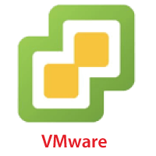
VMware Cloud
VMware cloud is a Software-Defined Data Center (SSDC) unified platform for the Hybrid Cloud.
It allows cloud providers to build agile, flexible, efficient, and robust cloud services.
Features of VMware
VMware cloud works on the pay-as-per-use model and monthly subscription
It provides better customer satisfaction by protecting the user's data.
It can easily create a new VMware Software-Defined Data Center (SDDC) cluster on AWS cloud by utilizing a RESTful API.
It provides flexible storage options. We can manage our application storage on a per-application basis.
It provides a dedicated high-performance network for managing the application traffic and also supports multicast networking.
It eliminates the time and cost complexity.

Slide 64
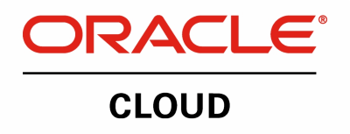
Oracle Cloud
Oracle cloud platform is offered by the Oracle Corporation.
It combines Platform as a Service, Infrastructure as a Service, Software as a Service, and Data as a Service with cloud infrastructure.
It is used to perform tasks such as moving applications to the cloud, managing development environment in the cloud, and optimize connection performance.
Features of Oracle cloud
Oracle cloud provides various tools for build, integrate, monitor, and secure the applications.
Its infrastructure uses various languages including, Java, Ruby, PHP, Node.js.
It integrates with Docker, VMware, and other DevOps tools.
Oracle database not only provides unparalleled integration between IaaS, PaaS, and SaaS, but also integrates with the on-premises platform to improve operational efficiency.
It maximizes the value of IT investments.
It offers customizable Virtual Cloud Networks, firewalls, and IP addresses to securely support private networks.

Slide 65

Red Hat
Red Hat virtualization is an open standard and desktop virtualization platform produced by Red Hat.
It is very popular for the Linux environment to provide various infrastructure solutions for virtualized servers as well as technical workstations.
Most of the small and medium-sized organizations use Red Hat to run their organizations smoothly.
It offers higher density, better performance, agility, and security to the resources.
It also improves the organization's economy by providing cheaper and easier management capabilities.
Features of Rad Hat
It provides secure, certified, and updated container images via the Red Hat Container catalog.
It cloud includes OpenShift, which is an app development platform that allows developers to access, modernize, and deploy apps
It supports up to 16 virtual machines, each having up to 256GB of RAM.
It offers better reliability, availability, and serviceability.

Slide 66

Digital Ocean
Digital Ocean is the unique cloud provider that offers computing services to the organization. It was founded in 2011 by Moisey Uretsky and Ben. It is one of the best cloud provider that allows us to manage and deploy web applications.
Features of Digital Ocean
It uses the KVM hypervisor to allocate physical resources to the virtual servers.
It provides high-quality performance.
It offers a digital community platform that helps to answer queries and holding feedbacks.
It allows developers to use cloud servers to quickly create new virtual machines for their projects.
It offers one-click apps for droplets. These apps include MySQL, Docker, MongoDB, Wordpress, PhpMyAdmin, LAMP stack, Ghost, and Machine Learning.

Slide 67
Cloud Computing Jobs

Slide 68
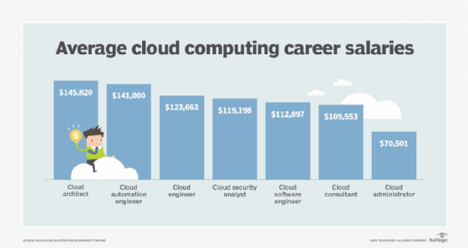
Cloud Computing Jobs

Slide 69
Cloud Computing Jobs
Cloud administrator
Average salary: $70,501
Cloud architect
Average salary: $145,820
Cloud automation engineer
Average salary: $141,000
Cloud consultant
Average salary: $109,553
Cloud engineer
Average salary: $123,663
Cloud security analyst
Average salary: $119,198
Cloud software engineer
Average salary: $112,897

Slide 70

Cloud Computing (IAT)
DU #2104CS521
Prof. Umesh Thoriya
Computer Engineering Department
umesh.thoriya@darshan.ac.in
9714233355

